Slide 1
Unpaved road detection based on spatial fuzzy clustering algorithm
Sai swaroop K, Mtech CSE
Hrishidev UT, Mtech CSE

Slide 2
Introduction
The intelligent vehicle remains a core problem in computer vision technology and has numerous potential applications, such as driver assistance, transportation system scheduling, and searching for the optimum route
Vision-based unpaved road detection is a challenging task due to the complex nature scene.
In this paper, a novel algorithm is proposed to improve the accuracy and robustness of unpaved road detection and boundary extraction with low computational costs.

Slide 3
Method
Below are the methods that can be used to detect Unpaved road:
(1) Vanishing line detection based on the normal distribution with infrared images.
(2) An image segmentation method that uses the double-Otsu algorithm and the trapezoid prediction is obtained.
(3) Image classification with the improved SVM and construction of the probability confidence map according to the classification results.
(4) Spatial fuzzy clustering algorithm based on FCM combined with the trapezoidal forecasting model and the probability confidence map to complete road recognition.

Slide 4
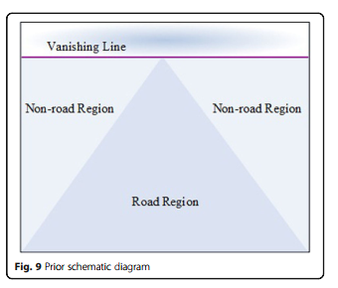
Clustering method
We use Otsu method to obtain connected regions and regard each of them as a data point followed by clustering.
The road region is generally in the lower middle image with a relatively stable grayscale value.
Divide the road into three categories.

Slide 5
Otsu method is a thresholding technique that is used to separate an image into two parts: foreground and background.
We apply spatial fuzzy clustering to the image to identify regions of similar intensity.
Fuzzy c-means (FCM) is a clustering algorithm. Unlike traditional clustering methods, where each data point is assigned to a single cluster, FCM allows for a data point to belong to multiple clusters simultaneously with varying degrees of membership.
The algorithm works by iteratively updating the membership values and cluster centroids until convergence is reached. In each iteration, the membership values for each data point are updated based on its distance from each cluster centroid and the degree to which it belongs to each cluster.

Slide 6
Segment the image that resulted from the fuzzy clustering into distinct regions of unpaved road and other areas using Morphological Operations

Slide 7
Load the image: Load the input image into the program.
Softening the image
Convert the image to grayscale: Convert the input image to grayscale, since Otsu's method requires a grayscale image.
Apply Otsu's method: Use Otsu's method to threshold the image into a binary image. This will separate the image into regions of high and low intensity, which can be used to identify the unpaved road regions.
Apply spatial fuzzy clustering: Apply spatial fuzzy clustering to the image to identify regions of similar intensity. This will group together pixels that have similar intensity values and spatial locations.
Segment the image: Use the results of the fuzzy clustering to segment the image into distinct regions of unpaved road and other areas using Morphological operations.
Visualize the results: Visualize the results of the segmentation to identify the unpaved road regions in the input image.

Slide 8
Thank you

